Slide 1
Statecharts: A Visual Formalism for Complex Systems
Jeff Peng
jpeng@u.arizona.edu
Model-based Design Lab

Slide 2
Agenda
Introduction: Statechart Diagrams
Statemate Semantics of Statechart
Statemate Working Environment
Statemate Tutorial
Further Readings

Slide 3
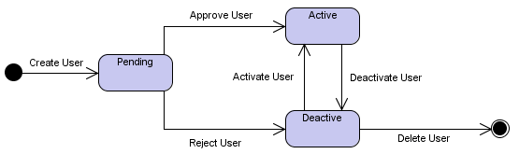
Introduction:
Statechart Diagrams
Design of complex reactive systems
Statechart in a nutshell
Basic notation:
  State
  Transition
  Initial State
  Final State
Notes:
The literature on software and systems engineering is almost unanimous in
recognizing the existence of a major problem in the specification and design of large
and complex reactive systems. A reactive system, in contrast with a
transfohnational system, is characterized by being, to a large extent, event-driven,
continuously having to react to external and internal stimuli. Examples include
telephones, automobiles, communication networks, computer operating systems,
missile and avionics systems, and the man-machine interface of many kinds of
ordinary software. The problem is rooted in the difficulty of describing reactive
behavior in ways that are clear and realistic, and at the same time formal and
rigorous, sufficiently so to be amenable to detailed computerized simulation. The
behavior of a reactive system is really the set of allowed sequences of input and
output events, conditions, and actions, perhaps with some additional information
such as timing constraints.
In a nutshell, statechart is simply a network of states and events.
Statechart diagrams, also referred to as State diagrams, are used to document the various modes ("state") that a class can go through, and the events that cause a state transition. For example, your television can be in the Off state, and when the power button is pressed, the television goes into the On state. Pressing the power button yet again causes a state transition from the On state to the Off state. In comparison the other behavioral diagrams which model the interaction between multiple classes, State diagrams typically model the transitions within a single class.

Slide 4

Statechart Diagrams: Notation
State: a mode of the entity.
A rectangle with rounded corners, and the state name
Notes:
The State notation marks a mode of the entity, and is indicated using a rectangle with rounded corners, and the state name written inside.

Slide 5

Statechart Diagrams: Notation
Transition: changing of the object State
An arrow, with the Event Name
Notes:
A Transition marks the changing of the object State, caused by an event. The notation for a Transition is an arrow, with the Event Name written above, below, or alongside the arrow.
Transitions
If event E occurs in state S and condition C holds then make the transition to state T.
Actions to be carried out when event E occurs in state S are normally put into an event-action table rather than part of the diagram. The actions could be lengthy and detailed.

Slide 6
Statechart Diagrams: Notation
Initial State: state of an object before any transitions
Marked using a solid circle
Only one initial state is allowed on a diagram

Slide 7
Statechart Diagrams: Notation
Final State: destruction of the object
A solid circle with a surrounding circle

Slide 8
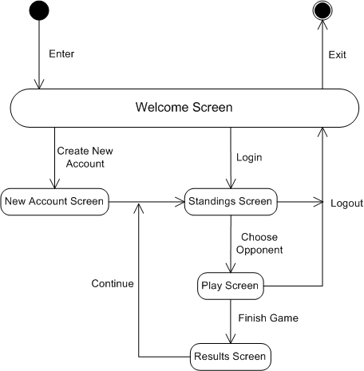
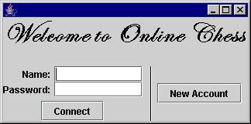
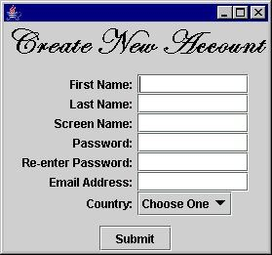
Example: Online Chess

